Slide 1
Chomsky Hierarchy of Languages
Lecture -11

Slide 2
Learning outcomes
At the end of this topic students should be able to:
Describe the relationship between different language types
Understand Chomsky hierarchy

Slide 3



Chomsky Hierarchy
Noam Chomsky developed a 4 level classification for grammars
Type 3 Regular Grammars
least powerful
can be accepted by DFA/NFA
can use subset of CFG, where all rules of the form:
A → a
A → aB (or A → Ba)
A → λ
Regular language is language expressed by a regular grammar
all regular languages are context-free
some context free languages are not regular (eg a^{n}b^{n} | n > 0)

Slide 4
Regular Grammar and CFG
Example: Consider the language defined by a(a*∪b*)b
S → aA
A → Xb | Yb
X → aX | λ
Y → bY | λ
We don’t have to restrict CFG to regular subset in order to describe a regular language:
Same language: a(a*∪b*)b
S → aMb A → e
B → bB B → e
M → A M → B
A → aA

Slide 5

Chomsky Hierarchy
Type 2 - Context Free Grammars
accepted by PDA
all rules have a single non-terminal on the LHS
Example: a ^{i} b ^{i}
S → aSb | λ
‘aSb’ is equivalent to
push X on PDA stack when input ‘a’
pop X off PDA stack when input ‘b’

Slide 6
CFG and PDA
Language accepted by PDA iff generated by a CFG
e.g a ^{i} c ^{j} d ^{j} b ^{i}
S → aSb | a X b
X → cXd | c d
Design a PDA for this language

Slide 7
Chomsky Hierarchy
Type 1 - Context Sensitive Grammars
More than one symbol permitted on LHS (but only 1 non-terminal)
e.g. uAv → uwv (means ‘A’ can only be replaced if ‘u’ is the prefix of A and v the suffix. The context of ‘A’ matters!)
accepted by a restricted Turing machine (called a linear-bounded automata - the length of the tape is limited)
Example:
S → abc | aSBc
cB → Bc
bB → bb
recognizes a ^{n}b ^{n}c ^{n}

Slide 8
Context Sensitive Grammars
S → abc | aSBc
cB → Bc
bB → bb
accept aaabbbccc ?
S ⇒ aSBc ⇒ aaSBcBc ⇒ aaabcBcBc ⇒ aaabBccBc ⇒ aaabbccBc ⇒ aaabbcBcc ⇒ aaabbBccc ⇒ aaabbbccc

Slide 9
Chomsky Hierarchy
Type 0 Unrestricted Grammars
can be accepted only by a Turing machine
any type of rule structure possible as long as at least one non-terminal is on the LHS (e.g. BA → D is OK)
Two types of language can result from unrestricted grammars
recursive
recursively enumerable
Turing Machines to be discussed later

Slide 10



Chomsky Hierarchy
Grammar | Languages | Machine | Production Rule of the form (e.g.)
Type - 3 | Regular | Finite state automaton | A → a A → aB |A → Ba A → λ
Type – 2 | Context-free | Pushdown automaton (non-deterministic) | S → aSb | λ
Type - 1 | Context-sensitive | Linear bounded automaton | S → abc | aSBc cB → Bc bB → bb
Type – 0 | Unrestricted | Turing Machine | BA → D
Regular ⊂ Context Free ⊂ Context Sensitive ⊂ Unrestricted

Slide 11
Grammar types
Various restrictions on rules provide various grammar types
Grammar Type | Restrictions | E.g.
Unrestricted (0) |  | AbC → AC
Context-sensitive (1) | |LHS| ≤ |RHS|??? | ABC → AaC???
Context-free (2) | |LHS| = 1 | A → AaC
Regular (3) | |LHS| = 1 and RHS ∈ {a, λ , aB} | A → a A → λ A → aB
Regular ⊂ Context free ⊂ Context Sensitive ⊂ Unrestricted

Slide 12
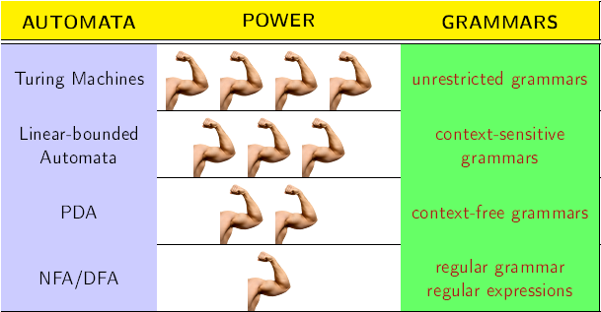
Chomsky Hierarchy

Slide 13
Unrestricted Grammars
Recursive language:
Turing machine eventually stops if string w is in language.
Machine will also eventually stop (and reject) if w is not in language
Recursively enumerable language:
Turing machine eventually stops if w is in language.
But machine may go into an infinite loop if w is not in the language

Slide 14
Remarks
Grammars are rules for string generation/replacement
All grammar classes are equivalent to some kind of automaton
PDAs and context-free grammars have the same power.
Deterministic PDAs are strictly weaker than CFGs.
There is no known simple grammar counterpart to DPDAs.

